Slide 1
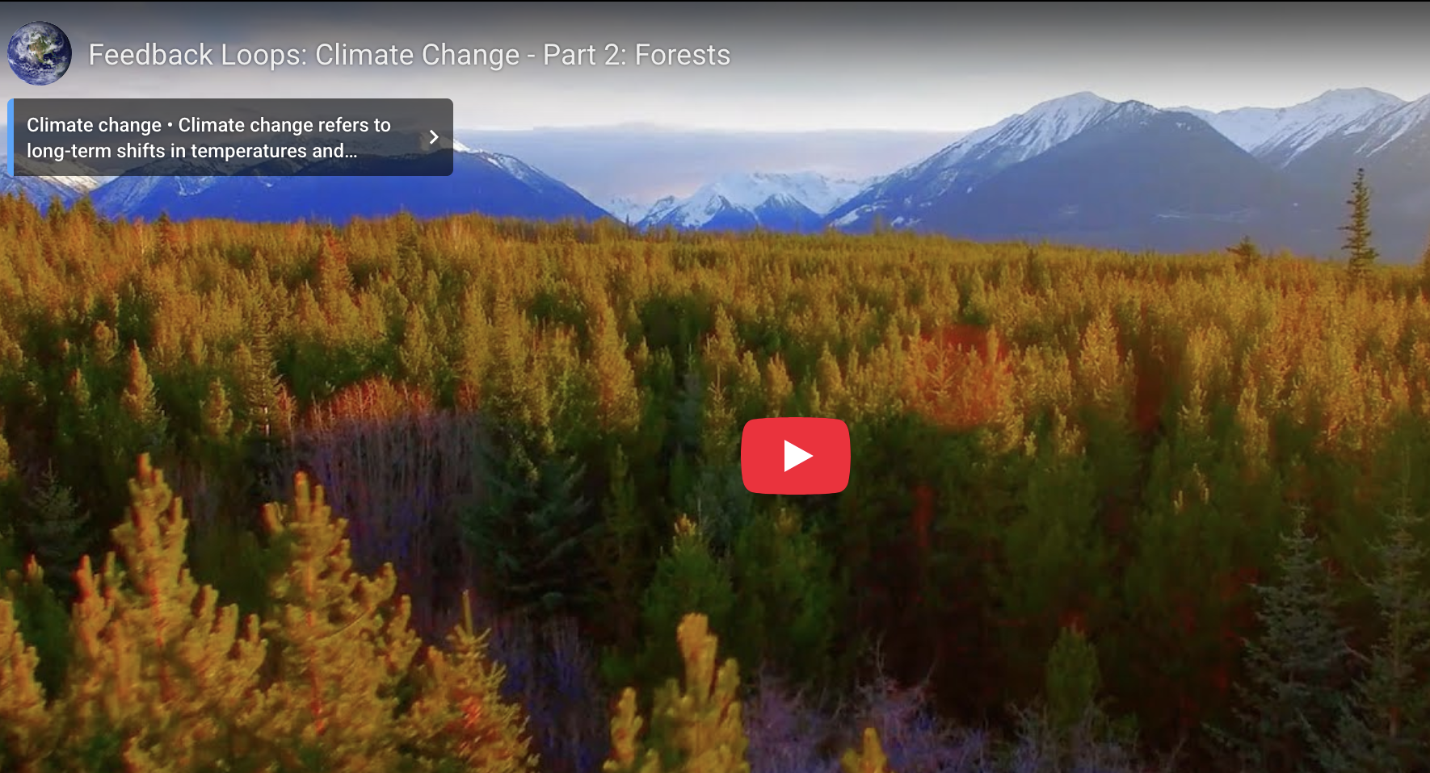
Another feedback loop (forests)
Climate Emergency: Feedback Loops
Director/Co-Writer: Susan Gray
Narrated by Richard Gere
~2021

Slide 2
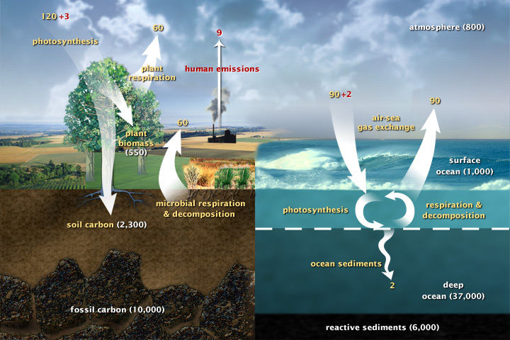
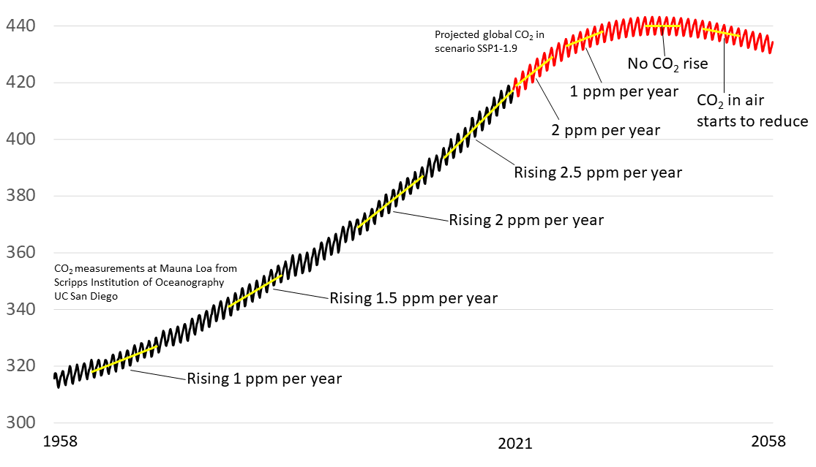
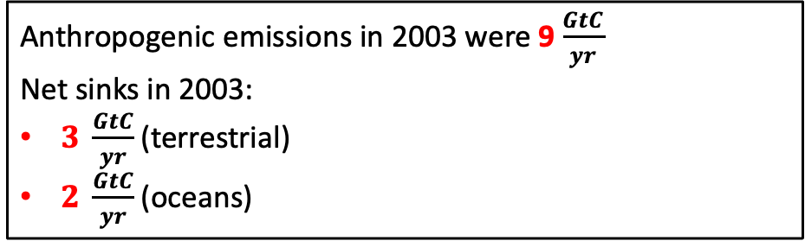
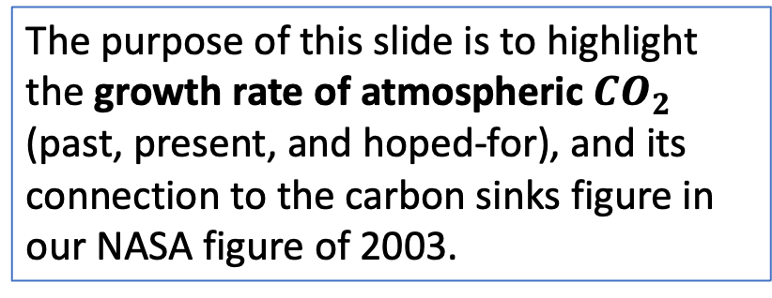
Connection between growth rate of atmospheric $CO_{2}$, emissions rates, and net carbon sinks
Anthropogenic emissions in 2003 were 9$\frac{GtC}{yr}$
Net sinks in 2003:
$3 \frac{GtC}{yr}$(terrestrial)
$2 \frac{GtC}{yr}$(oceans)
2003
The purpose of this slide is to highlight the growth rate of atmospheric $CO_{2}$ (past, present, and hoped-for), and its connection to the carbon sinks figure in our NASA figure of 2003.
2003
https://allianceforscience.org/wp-content/uploads/2022/01/Keeling-curve-with-SSP1-1.9-all-trend-labels.png

Slide 3
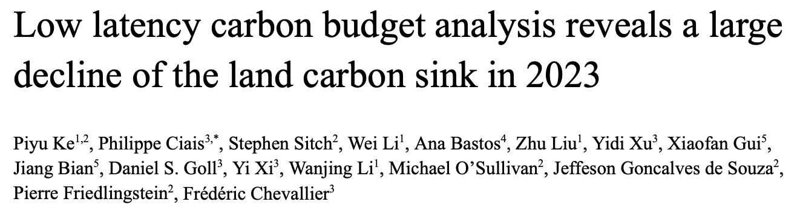
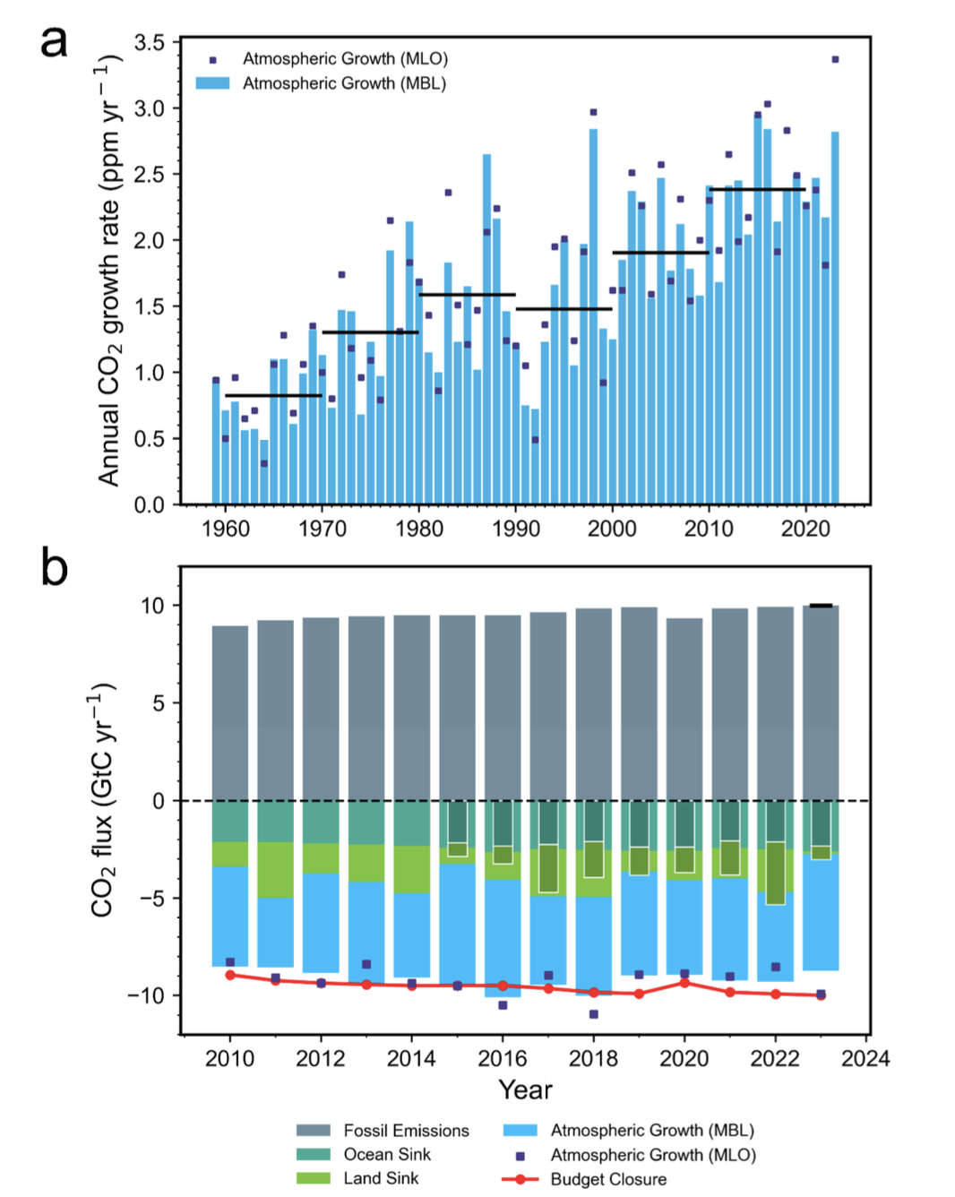
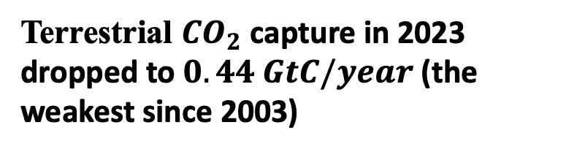
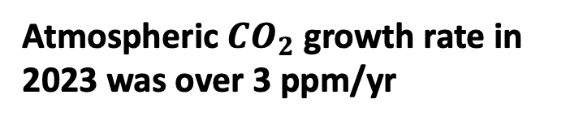
What changed in 2023: the terrestrial carbon sink
Terrestrial $CO_{2}$ capture in 2023 dropped to $0.44 GtC/year$ (the weakest since 2003)
Atmospheric $CO_{2}$ growth rate in 2023 was over 3 ppm/yr

Slide 4
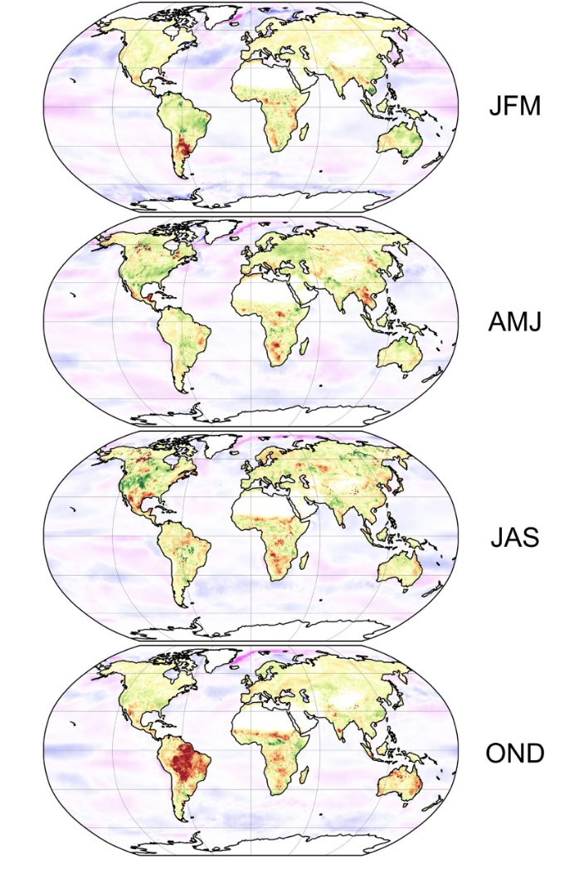
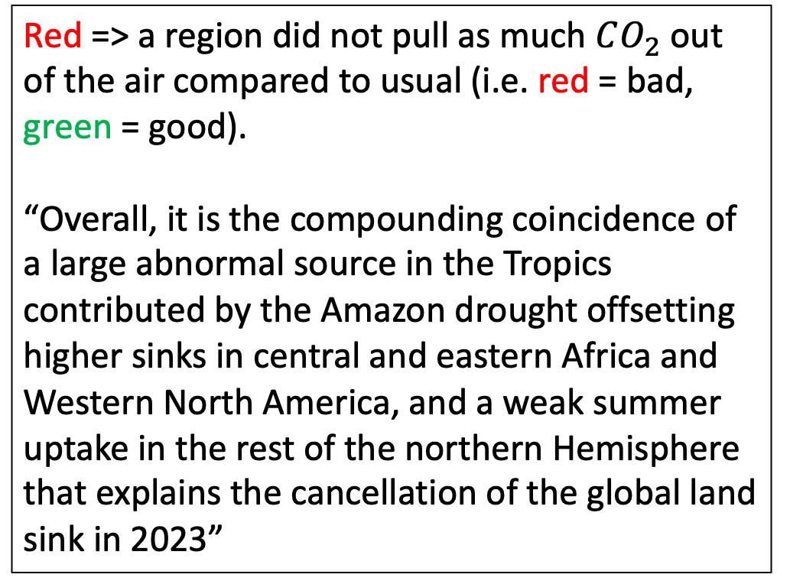
Where did we lose the sink?
2023
Red => a region did not pull as much $CO_{2}$ out of the air compared to usual (i.e. red = bad, green = good).
“Overall, it is the compounding coincidence of a large abnormal source in the Tropics contributed by the Amazon drought offsetting higher sinks in central and eastern Africa and Western North America, and a weak summer uptake in the rest of the northern Hemisphere that explains the cancellation of the global land sink in 2023”
NH winter
---------------
SH summer
NH spring
---------------
SH fall
NH summer
---------------
SH winter
NH fall
---------------
SH spring

Slide 5
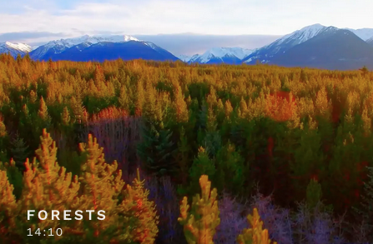
It’s not like the trend is a huge surprise, it’s just coming on faster than we thought
2021 (Richard Gere and friends)

